Slide 1
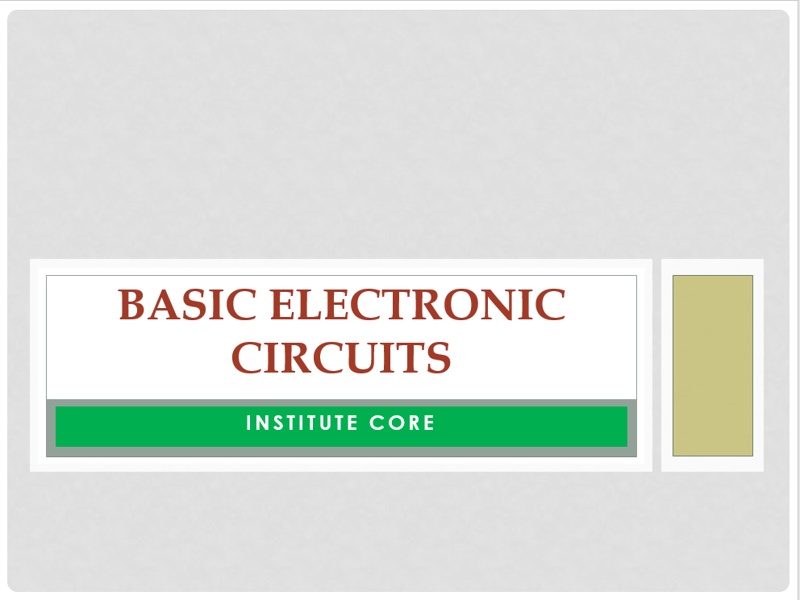

Slide 6
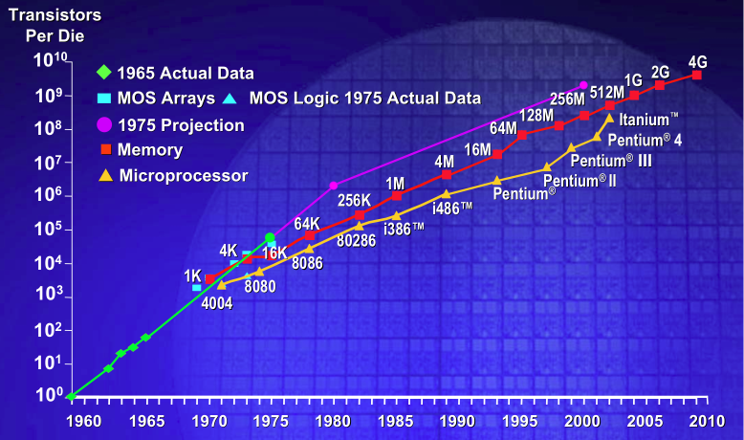
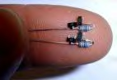
Smaller Transistors
Higher Switching Speeds
Declining Costs
Notes:
Silicon has been the heart of the world's technology boom for nearly half a century, but microprocessor manufacturers have all but squeezed the life out of it. The current technology used to make microprocessors reached its limit around 2005.

Slide 7
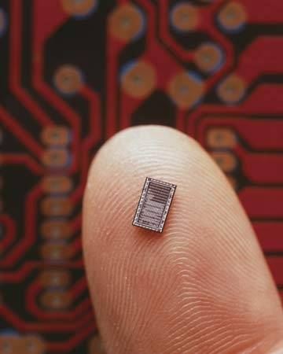
The semiconductor industry has been successful in its consistent efforts to reduce feature size on a chip.

Slide 8
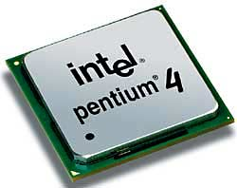
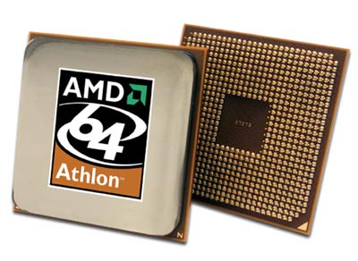
55,000,000 transistors
105,900,000 transistors
Smaller features mean denser packing of transistors, which leads to more powerful computers, more memory, and hopefully lower costs.

Slide 9
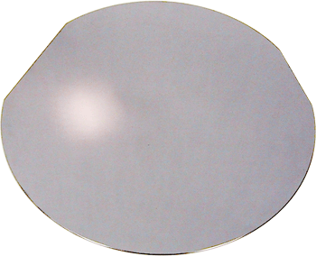
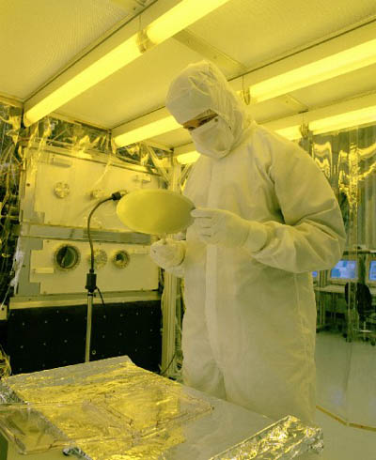
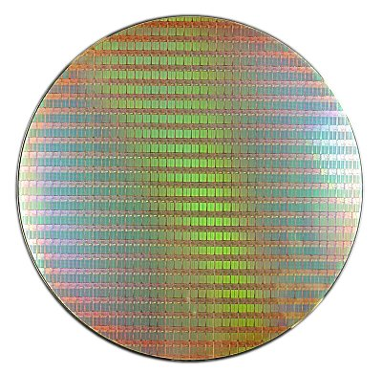

Slide 10
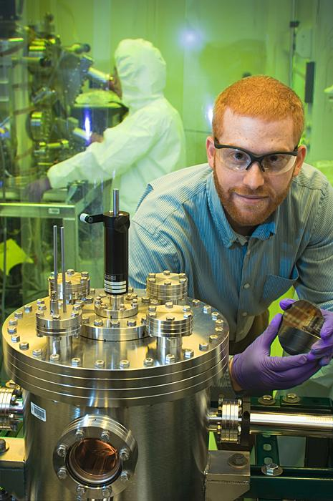
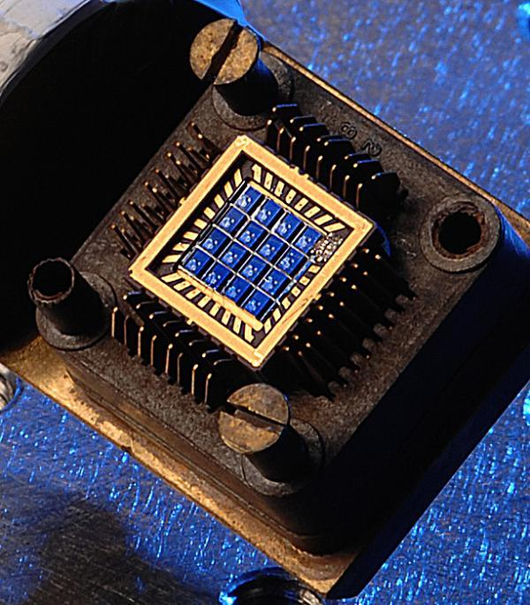

Slide 11
THANK YOU

